Slide 1
Ash Winter
Short stuff here:
@northern_tester
Long stuff here:
testingisbelieving.blogspot.co.uk

Slide 2
Improving Testing Through Operability

Slide 3
What do I mean by operability?
How well a software system works when operating live
Minimise time, cost and effort from unplanned interventions

Slide 4
What does good operability look like?
Easy to deploy, test and interrogate
Usable information on state of service
Predictable and non-catastrophic failure modes
Usable for internal stakeholders
Removes toil, increases humane work
Operational concerns alongside user-visible features

Slide 5
Operability and testing
Observability of the unknown
Monitoring of the obvious
Controllability
Risk identification
Discuss failure modes

Slide 6
Operability and testing
Information on performance & capacity
Recoverable & resilient
Less false positives & negatives
Uptime means testing time
And many more

Slide 7
My operability story…
Performance testing?
A new development function
Terraforming environments
New live and test environments
New Jenkins build servers

Slide 8
My operability story…
Network connectivity
Infra test automation
Monitoring & alerting
Log rotation & aggregation
Circuit Breakers
Even VPN…

Slide 9
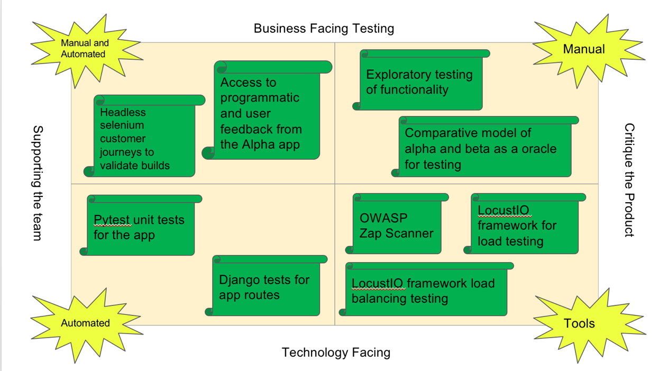
In the end, great, balanced testing!

Slide 10
What’s your story?
Cloud migration?
Re-platforming?
Expanding?
Rewriting?
Replacing entirely?
Or just interested in how operability and testing are linked?

Slide 11

Follow the path…
Runbook – operability test strategy
Logging – simple logging and adding structure for machine readability.
Alert – determining normal with the team and showing the difference.
Hooks – control yourself and your application

Slide 12
Stretch…
Aggregate – bringing logs together
Decompose – techniques for isolating applications

Slide 13

Exercises
Groups
Code Along
Pair if you wish
Help each other
Visible
Questions
Breaks

Slide 14
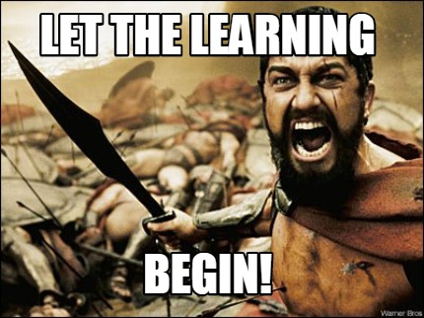
Begin!

Slide 15
Our Application Under Test

Slide 16
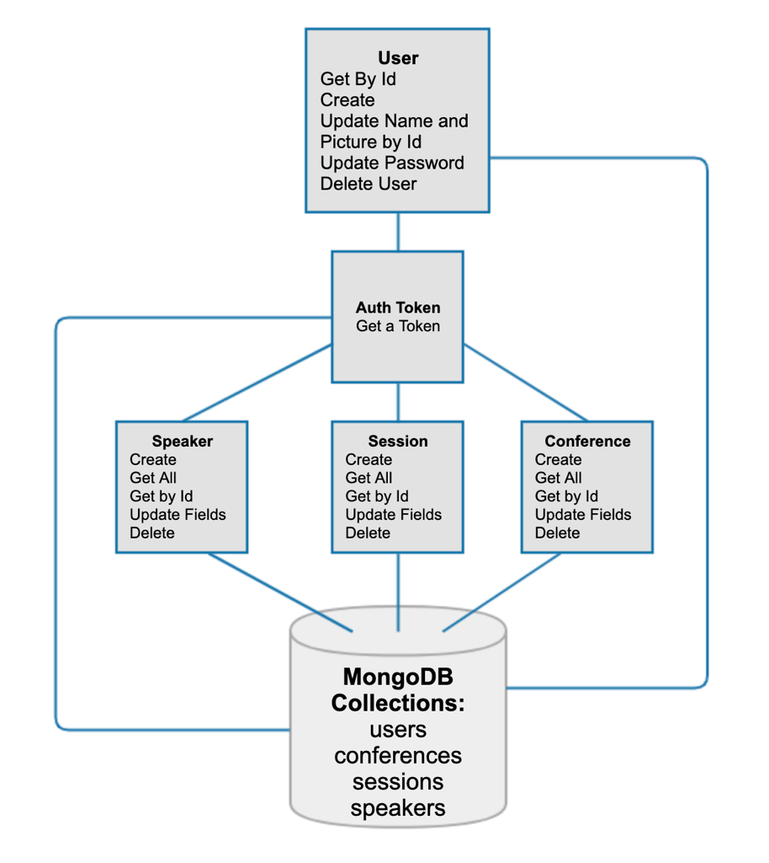
User creates an
auth token
Create a user or admin with
Master Token
Use that auth token
to invoke other endpoints,
some are admin

Slide 17
The fun part…
MongoDB
Node and NPM
Robo3T
Postman
An editor
The app

Slide 18
Up and running
Pull the latest from the repo
Open in your editor
Terminal > Root of App > Type “npm install”
Terminal > Root of App > Type “npm run dev”

Slide 19
Postman Collection
Create a User
Create an admin user
Create an Auth Token for both
Postman Variables

Slide 20
Documentation
Autogenerated docs
An important operability win!
Terminal > Root of App > Type “npm run docs”
A project with actual docs!

Slide 21
Testing feedback?
Anyone do any testing?
Managed to operate the app?
Bugs found?
Insights to share?
Burning questions?
Terrified?

Slide 22
For familiarity
Tests in Speakers Endpoint for:
Get
Put
Test in Sessions Endpoint for:
Delete

Slide 23
Ready?

Slide 24
Advocating for Operability to Improve Test Strategy

Slide 25
What is a Run Book?
A Run Book is a set of headings and questions that cover operational concerns in most software systems.

Slide 26
Why is it important?
System & business context
Who owns/knows what
Management of incidents and outages
Locations & meaning of logs, monitoring and health checks
Restoring service & failover strategies
Deployment/rollback
Any many more

Slide 27
Your run book experience…
Heard of one?
For your application?
Take part in creating it?
Ever done an incident post mortem
Are on call support?

Slide 28
What is a (good) test strategy?
Balanced but varied
Inclusive of team testing activities
Evolves with context
Starts a conversation
Business risk
Any more?

Slide 29
Run books and test strategies
About discovery & exploration
Designed to provoke discussion
Best as a whole team effort
Shows gaps in system and technology knowledge

Slide 30
Hypothesis: Completing a run book for your system will improve your testing…

Slide 31
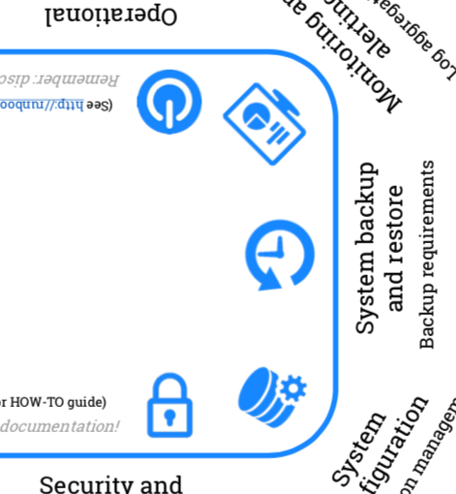
Stage 1: Run Book Template
Handout of dialogue sheet
Explanatory notes: http://tiny.cc/77145y
Think about how you this information helps your testing
Thanks to Matthew Skelton for this awesome template and research

Slide 32
Stage 2: Draw the Testing Quadrants
Thanks to various including Lisa Crispin, Janet Gregory, Brian Marick

Slide 33
Stage 3: Bring them together
Add elements of the run book to your quadrants based on:
Best suited quadrant for that info
Type of testing that would benefit most
Business Overview
Patching

Slide 34
Reflect…

Slide 35
Next!

Slide 36
Implementing Effective Logging

Slide 37
Not very exciting…
Ugh, logging
Later…
Replication
How do you use your application logs?

Slide 38
Basics…
Terminal > Root of App > Type “npm run dev”
nodemon
morgan
Web logs
Mongo logs
stdout

Slide 39
Intermediate…
What is useful to a tester to log?
Create a bespoke morgan format using morgan docs
Negative tests for user management

Slide 40
Targeting…
Creating a unique id
Tracing in distributed systems
Add to our web logging
Generate a unique id

Slide 41
Structured Logging
Readability for machines
Tools can assist your testing
Manual searches of log files are fallible
Grep is good, but not enough

Slide 42
Structured Logging
Logging structured data to console
Mongo
Web
Add coverage for missing requests

Slide 43
Where’s the risk?
What could go wrong?
How can logging help us?

Slide 44
Event Identifiers
Clear, consistent naming
Alerting on failure
Alerting on deployment
Metrics on usage

Slide 45
Diagnostic Events
Application start up
Initial database connection
Database connection errors
Trigger the error…

Slide 46
Business Events
Add an eventLookup
Successful user creation
Unsuccessful user creation
What could a tester use these for?

Slide 47
Ready for a break?

Slide 48
Monitoring and Alerting Assisted Testing

Slide 49
What is monitoring?
Monitoring is continuously gauging your system against a perceived normal, proactively alerting against deviances

Slide 50
Why is it important?
Agility
Outages
Inevitable failure
Dependencies
Capacity
Data for advantage
Infrastructure
Config changes

Slide 51
Your monitoring experience…
Got access?
Used to guide your testing?
Contributed to it?
Designed an alert?
Same in test & live?

Slide 52
Time Series Databases
New data is almost always a new entry
Typically arrives in time order
Databases that are indexed by time

Slide 53
Instrumentation
Changing the source code to monitor:
Performance
Errors
Tracing of journeys
Really useful for testing!

Slide 54
Hypothesis: Instrumenting your system for monitoring gives crucial information for testing

Slide 55
Stage 1: Prometheus
Install and run
Hit the url
Prometheus.yaml
Global
Alerting
Rule files
Scrape Configs
/metrics
Job names

Slide 56
Stage 2: /metrics
src/api /metrics
Postman or Web
Prom-client
Default
Histogram
Counter
Gauge
Summary
Timers

Slide 57
Stage 3: Instrumentation
Prometheus-api-metrics
Add to services/ express/ index.js
Run your collections
Data!

Slide 58
Stage 4: Querying Data
Average
Count
Rate
Sum
Parameters
Time
Percentiles
By

Slide 59
Stage 5: Have a go!
Median response time for creating users
95th Response Time by specific route and status code
Apdex for conferences endpoint

Slide 60
Alerting for the Normal

Slide 61
Symptom Based Alerts
Users
Basic availability
Correctness
Latency
Freshness
Features

Slide 62
Cause Based Alerts
Bad
Catch the symptom anyway
Maybe you caused it!
Necessary for “almosts”

Slide 63
Stage 1: Stop the App
Kill your app
Prometheus
Alert Manager
What do you notice?

Slide 64
Stage 2: Status Codes
Add a code based alert to rules.yaml
404 – broken links
Yaml…
Whats the cause?

Slide 65
Stage 3: Symptom Alert
Add an alert for something a user might care about.
Available
Fast
Fresh
Features

Slide 66
Stage 4: Cause Alert
Add an alert for a system problem.
CPU
Memory
Threads

Slide 68
Testability Operability Hooks

Slide 69
Query and Control Points
Hooks
Query
Control
Liveness
Readiness

Slide 70
First Class Features
Resistance
Purity of the model
Would cars be built without diagnostic ports?

Slide 71
Focus on API Hooks
Snapshot – the ability to query state quickly and easily
Action – the ability to (re)set state to a known value

Slide 72
Draw the app
Snapshot hooks
Action hooks
What if the API served a mobile app?

Slide 73
Build a Snapshot Hook!
Start in src/api/index.js
New folder in api/
Basics
Mongo model

Slide 74
What else?
Mongoose docs
What other methods can we use?

Slide 75
Almost there!

Slide 76
Improving Testing Through Operability

Slide 77
We’ve covered…
Runbook – operability test strategy
Logging – simple logging and adding structure for machine readability.
Alerts – determining normal with the team and showing the difference.
Hooks – control yourself and your application

Slide 78
Its all linked
Better operability improves testing
Makes testing more humane
Easier to sell to stakeholders

Slide 79
Log Rotation & Aggregation
Leverage large volumes of data safely
Early problem detection
Security
Capacity
Compliance
Improve what and how you test. With actual data!

Slide 80
Decomposability
Everything fails
Isolate the risky
Protect the important
Availability
Circuit Breakers
Mocks and stubs

Slide 81
In the end, great, balanced testing!

Slide 82
And really happy ops people!

Slide 83
Thank you

